Slide 1
Based on the Commission Proposal for Horizon Europe, the common understanding between co-legislators and the Partial General Approach, both approved in April 2019

Slide 2
  Horizon Europe -
  Model Grant Agreement
Disclaimer: Information not legally binding

Slide 3

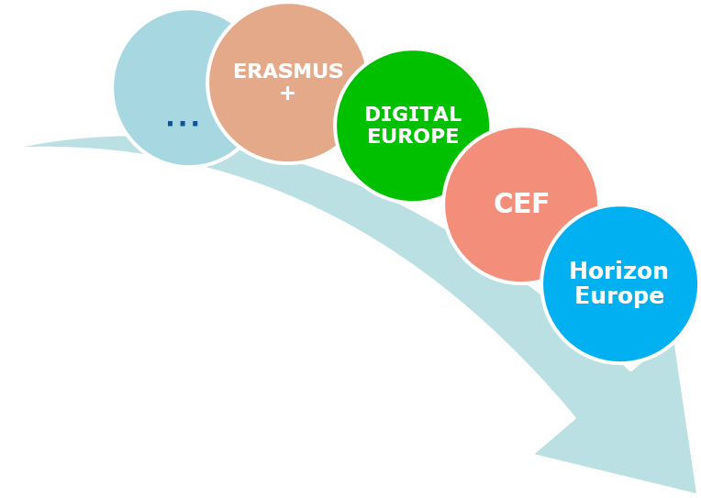
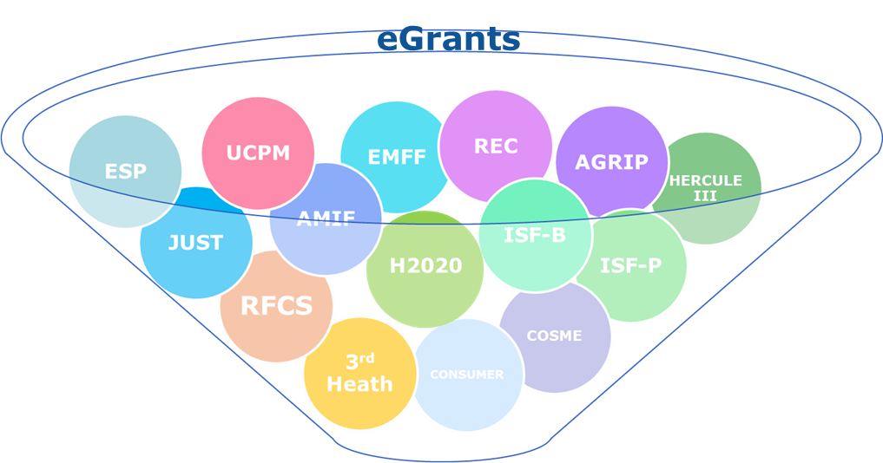
A bit of background…
Numerous Model Grant Agreements (MGAs):
paper-based or electronically-managed (‘eGrants’)
eGrants serving already for several programmes + to serve for other programmes

Slide 4
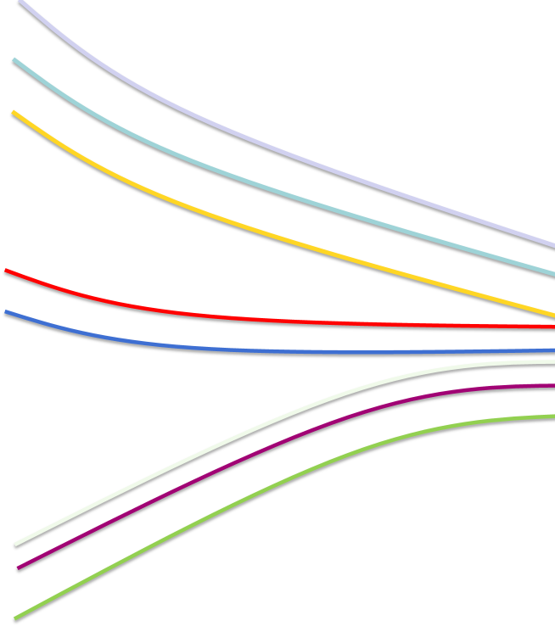
Objectives
Rationalization and streamlining of the MGAs landscape
Harmonisation & standardisation
  Harmonise the contractual models and guidance for all post-2020 programmes
  Build on the standardisation of post-2020 basic acts
Consistent
interpretation
  Use the same terminology across programmes
  Ensure uniform and consistent interpretation of rules
  Allow equal treatment of beneficiaries
  Create synergies between programmes
Integration of programme specifics
  Allow for encompassing the specifics of programme
  Specific options and specific annex with 'special rules’
Notes:
Investing in research and innovation is investing in Europe’s future. It helps us to compete globally and preserve our unique social model and European way of life.
R&I improves the daily lives of millions of people here in Europe and around the world, helping to solve some of our biggest societal and generational challenges.
The Horizon Europe proposal significantly contributes to achieve the Commission's priorities and the global policy priorities.
This includes foremost the Sustainable Development Goals as well as the climate objectives in line with the Union's commitment to implement the Paris Agreement.
Regarding the latter the contribution expected from this programme is increased to 35% to reach the overall target of 25% of the Union expenditure.

Slide 5

Structure
CORE PART
Special Rules Annex
Options at:
  Programme-level (or action-type level)
  Call-level
  MGA-level
  Programme-specifics rules, e.g. for Horizon Europe:
  IPR
  Open Access
  Research Integrity
  Researchers working conditions etc…
Options at:
  Programme-level (or action-type level)
  Call-level
  MGA-level
Notes:
Investing in research and innovation is investing in Europe’s future. It helps us to compete globally and preserve our unique social model and European way of life.
R&I improves the daily lives of millions of people here in Europe and around the world, helping to solve some of our biggest societal and generational challenges.
The Horizon Europe proposal significantly contributes to achieve the Commission's priorities and the global policy priorities.
This includes foremost the Sustainable Development Goals as well as the climate objectives in line with the Union's commitment to implement the Paris Agreement.
Regarding the latter the contribution expected from this programme is increased to 35% to reach the overall target of 25% of the Union expenditure.

Slide 6
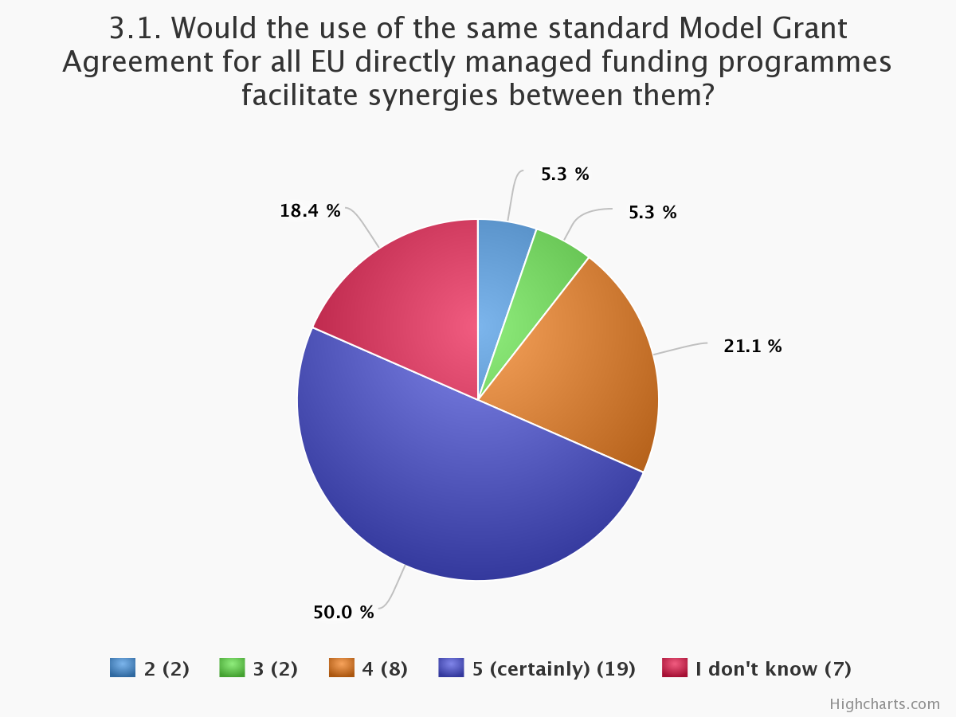
Your contribution to Horizon Europe Co-design
Results of the on-line consultation – Bulgarian respondents
SYNERGIES?
Bringing together money from different EU programmes in the same project
Providing funding from alternative sources for successful proposals which could not be funded due to insufficient call budgets
Funding complementary or successive projects

Slide 7
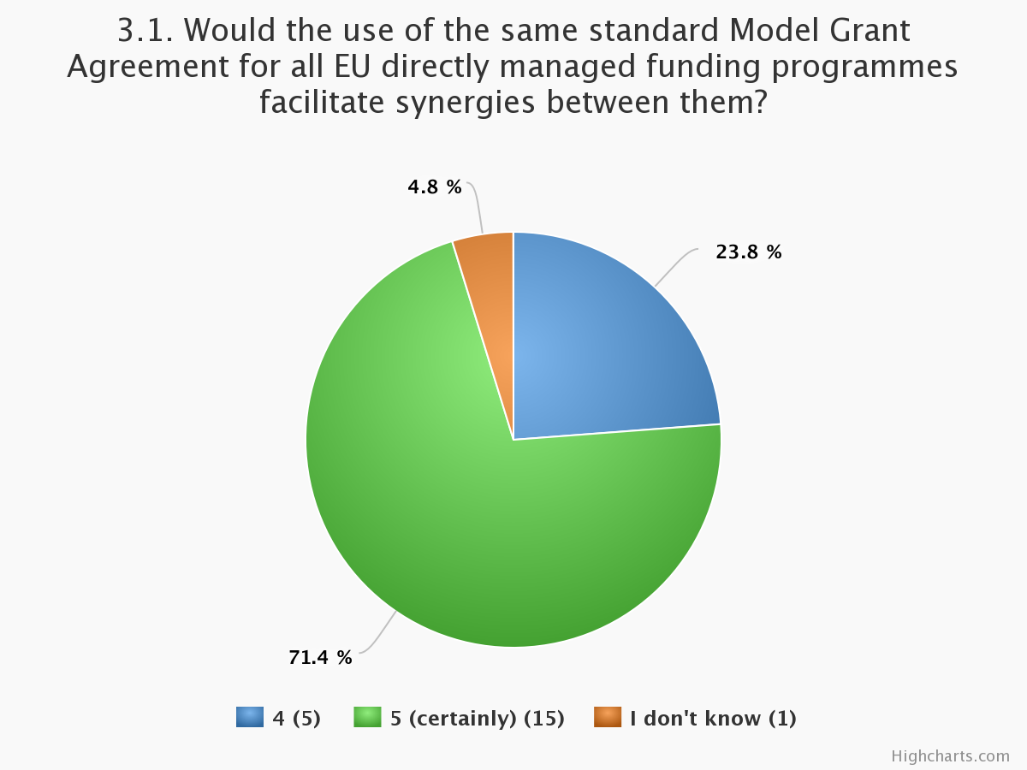
Your contribution to Horizon Europe Co-design
Results of the on-line consultation – Romanian respondents
SYNERGIES?
Bringing together money from different EU programmes in the same project
Providing funding from alternative sources for successful proposals which could not be funded due to insufficient call budgets
Funding complementary or successive projects

Slide 8
  Horizon Europe -
  Personnel costs

Slide 9
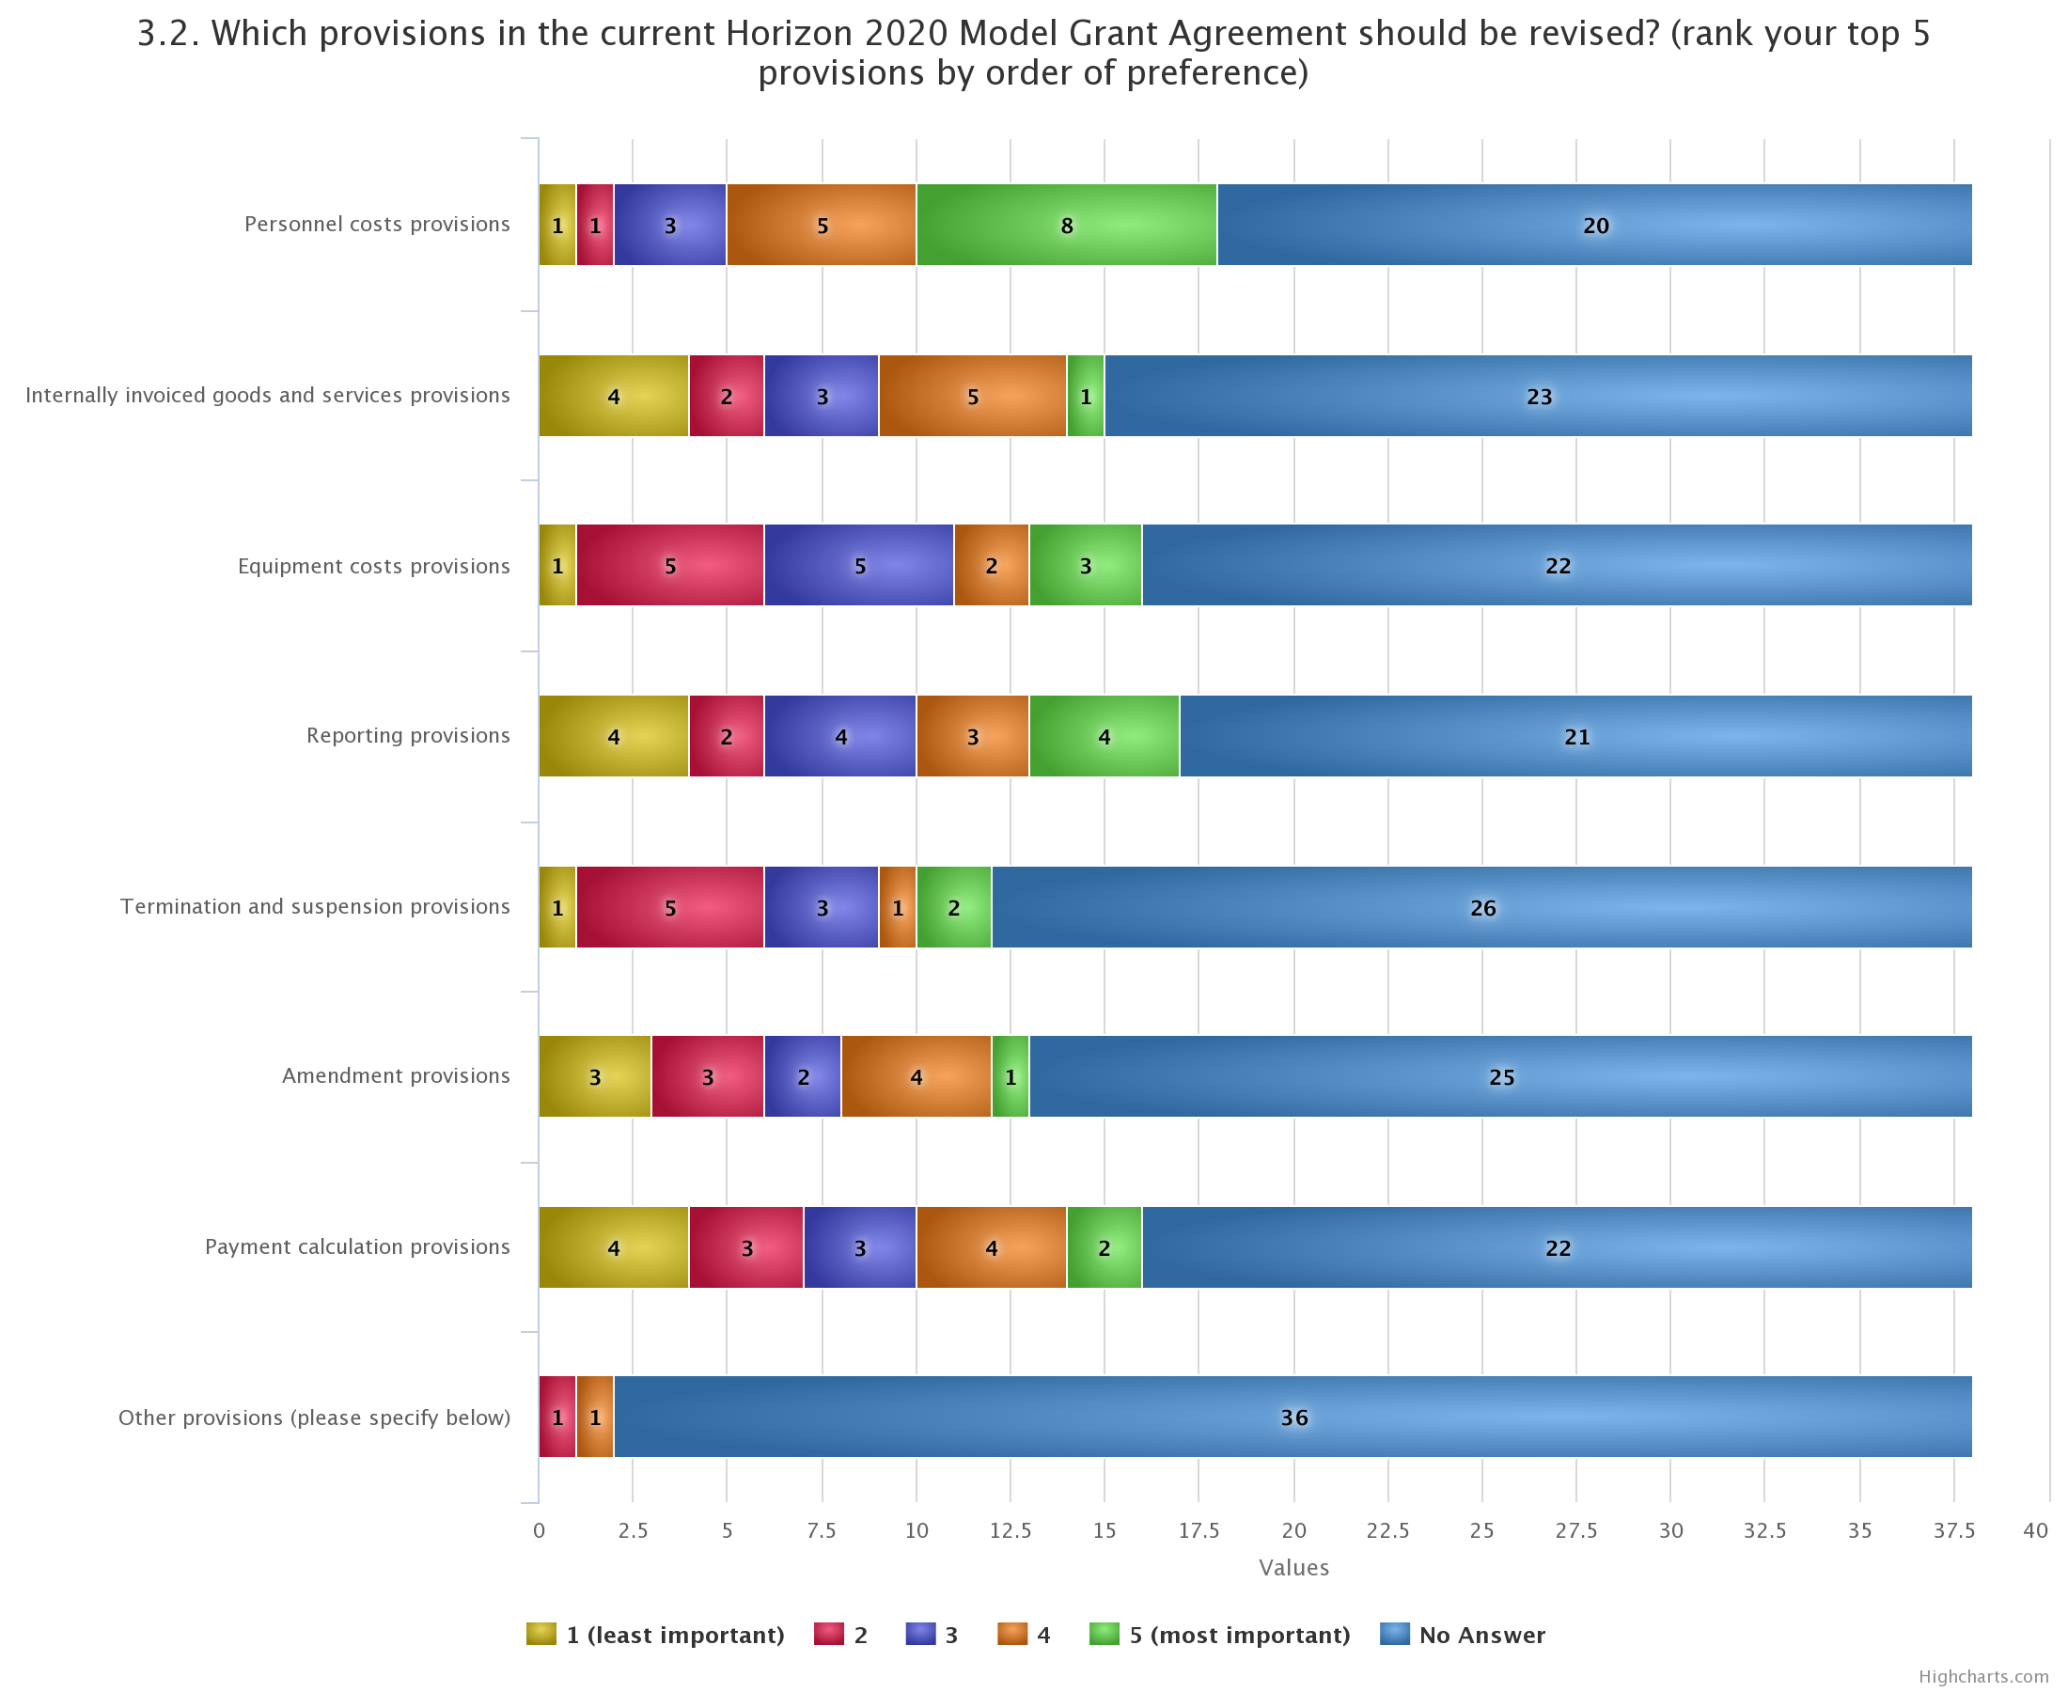

Your contribution to Horizon Europe Co-design
Results of the on-line consultation – Bulgarian respondents

Slide 10
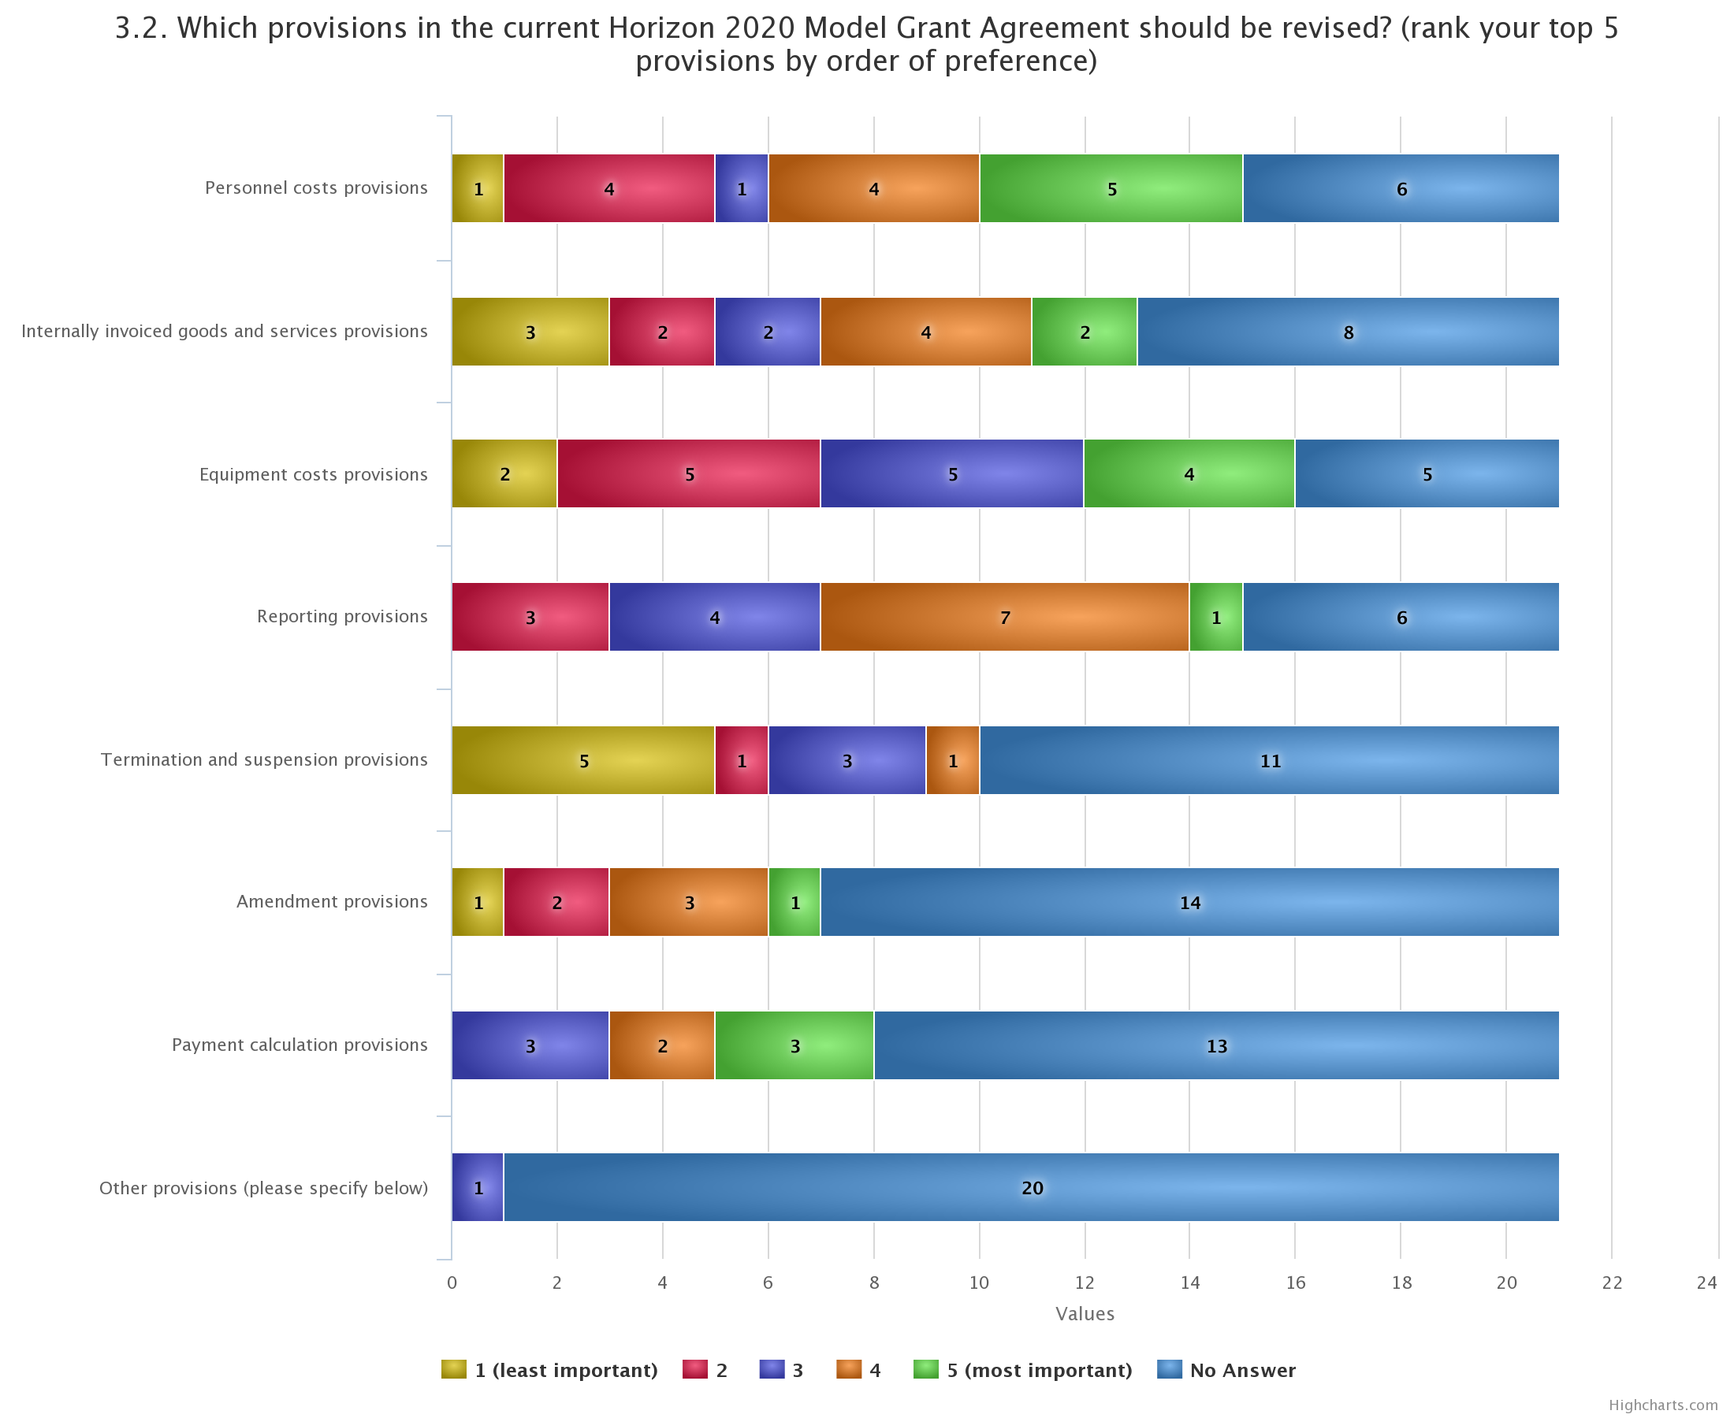
Your contribution to Horizon Europe Co-design
Results of the on-line consultation – Romanian respondents

Slide 11
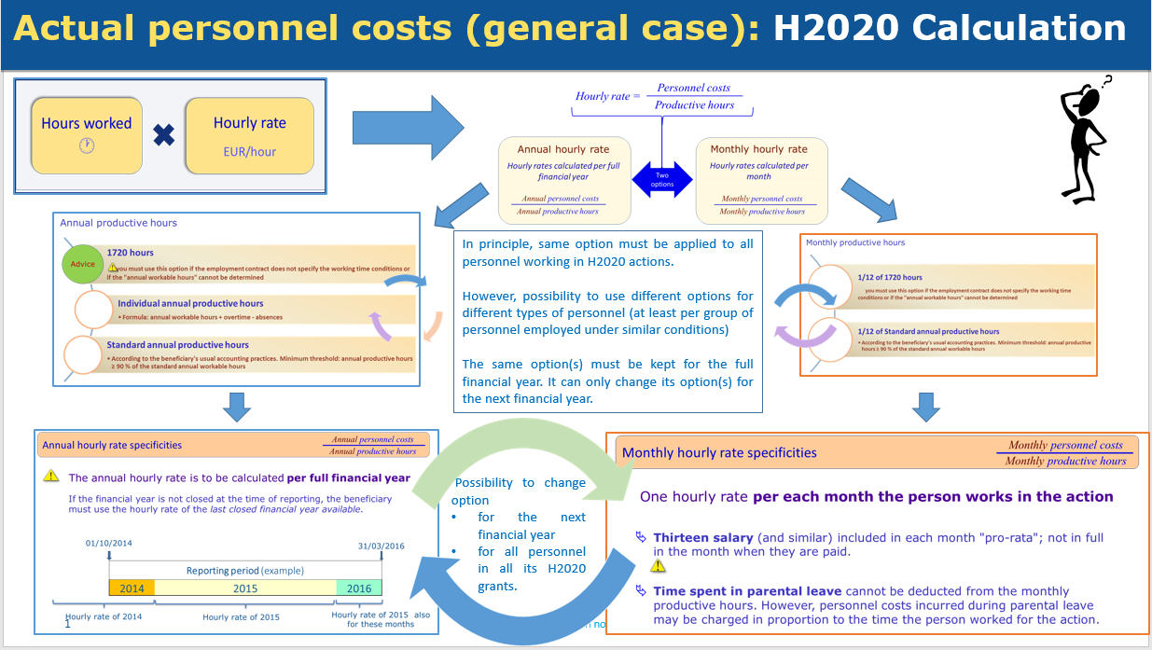
The situation today…
Notes:
Investing in research and innovation is investing in Europe’s future. It helps us to compete globally and preserve our unique social model and European way of life.
R&I improves the daily lives of millions of people here in Europe and around the world, helping to solve some of our biggest societal and generational challenges.
The Horizon Europe proposal significantly contributes to achieve the Commission's priorities and the global policy priorities.
This includes foremost the Sustainable Development Goals as well as the climate objectives in line with the Union's commitment to implement the Paris Agreement.
Regarding the latter the contribution expected from this programme is increased to 35% to reach the overall target of 25% of the Union expenditure.

Slide 12
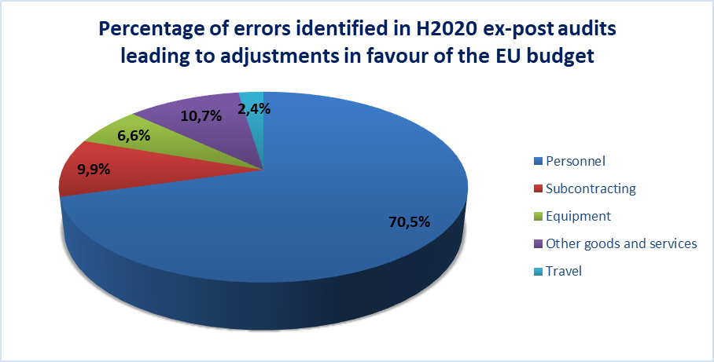
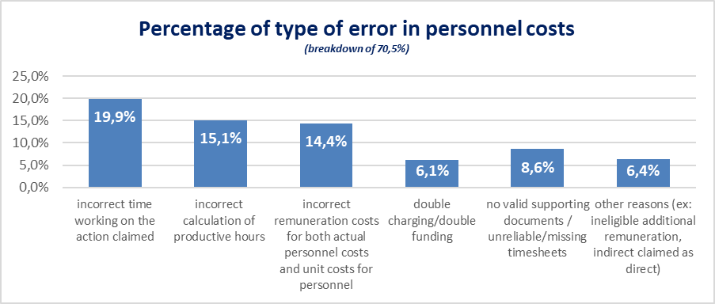
… and its consequences
Notes:
Investing in research and innovation is investing in Europe’s future. It helps us to compete globally and preserve our unique social model and European way of life.
R&I improves the daily lives of millions of people here in Europe and around the world, helping to solve some of our biggest societal and generational challenges.
The Horizon Europe proposal significantly contributes to achieve the Commission's priorities and the global policy priorities.
This includes foremost the Sustainable Development Goals as well as the climate objectives in line with the Union's commitment to implement the Paris Agreement.
Regarding the latter the contribution expected from this programme is increased to 35% to reach the overall target of 25% of the Union expenditure.

Slide 13

The situation tomorrow…
NEW
Corporate approach
Daily rate
Days worked
    Daily rate =
        annual personnel costs for the person
        215
    with no more obligation to use the ‘last closed financial year’!
    Days worked =
    Monthly declarations instead of time sheets
Notes:
Investing in research and innovation is investing in Europe’s future. It helps us to compete globally and preserve our unique social model and European way of life.
R&I improves the daily lives of millions of people here in Europe and around the world, helping to solve some of our biggest societal and generational challenges.
The Horizon Europe proposal significantly contributes to achieve the Commission's priorities and the global policy priorities.
This includes foremost the Sustainable Development Goals as well as the climate objectives in line with the Union's commitment to implement the Paris Agreement.
Regarding the latter the contribution expected from this programme is increased to 35% to reach the overall target of 25% of the Union expenditure.

Slide 14
Project-based remuneration (Art 32 HE RfP)
Similar rules as in H2020 but with the following simplifications:
        Current AGA explanations about ‘National Projects Reference’ incorporated in the MGA (for clarity and legal certainty)
        No more obligation to have paid at least once a project-based remuneration before the submission of the HE proposal
        If not applicable national law or internal rules, simpler and more flexible ‘fall-back’ option:
          No obligation to use last closed financial year for calculating the average remuneration of the person
Notes:
Investing in research and innovation is investing in Europe’s future. It helps us to compete globally and preserve our unique social model and European way of life.
R&I improves the daily lives of millions of people here in Europe and around the world, helping to solve some of our biggest societal and generational challenges.
The Horizon Europe proposal significantly contributes to achieve the Commission's priorities and the global policy priorities.
This includes foremost the Sustainable Development Goals as well as the climate objectives in line with the Union's commitment to implement the Paris Agreement.
Regarding the latter the contribution expected from this programme is increased to 35% to reach the overall target of 25% of the Union expenditure.

Slide 15
  Horizon Europe -
  Internal invoices unit cost

Slide 16
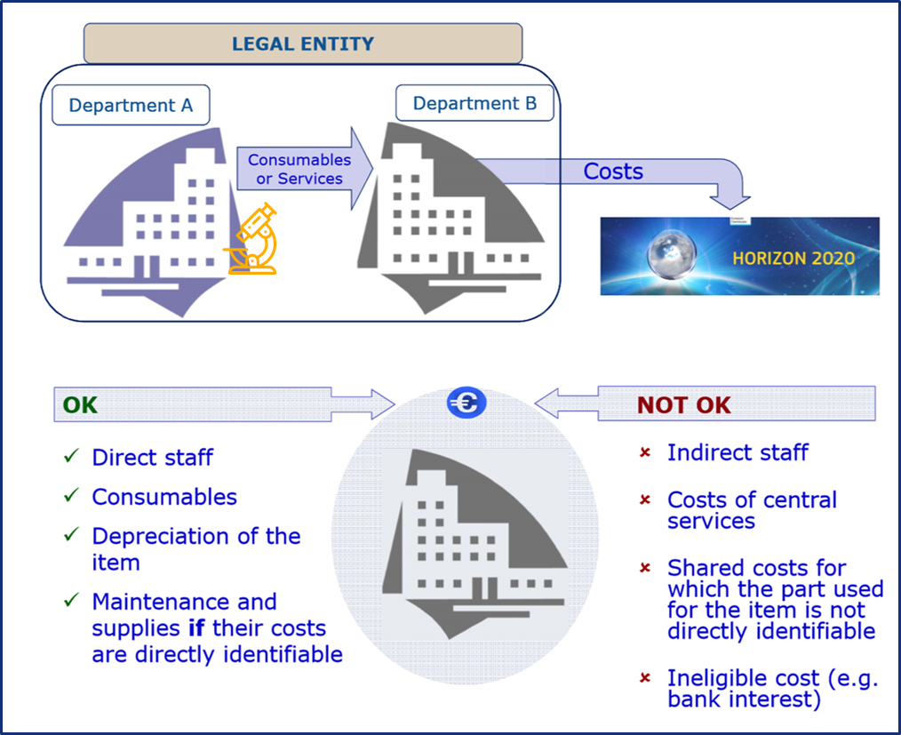
The situation today…
Notes:
Investing in research and innovation is investing in Europe’s future. It helps us to compete globally and preserve our unique social model and European way of life.
R&I improves the daily lives of millions of people here in Europe and around the world, helping to solve some of our biggest societal and generational challenges.
The Horizon Europe proposal significantly contributes to achieve the Commission's priorities and the global policy priorities.
This includes foremost the Sustainable Development Goals as well as the climate objectives in line with the Union's commitment to implement the Paris Agreement.
Regarding the latter the contribution expected from this programme is increased to 35% to reach the overall target of 25% of the Union expenditure.

Slide 17
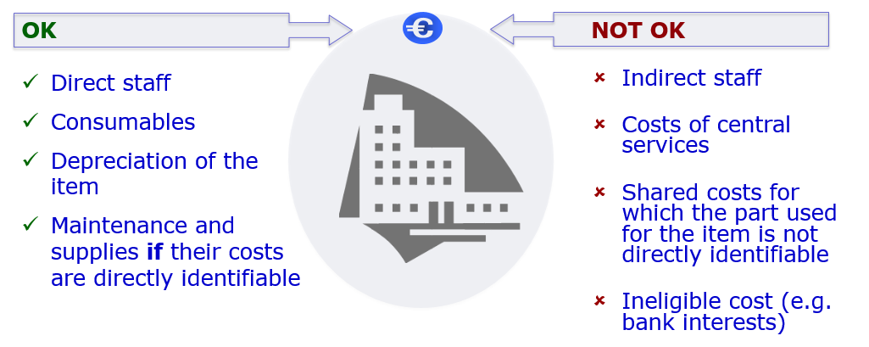
The situation tomorrow…
Wider reliance on beneficiary’s usual cost accounting practices (Art 31 HE RfP).
Possibility to accept actual indirect costs allocated via key drivers in the unit cost, if beneficiary’s usual cost accounting practices!
No application of the 25% flat-rate on top of the unit cost
Eligible
Eligible
Eligible
NOT eligible
Notes:
Investing in research and innovation is investing in Europe’s future. It helps us to compete globally and preserve our unique social model and European way of life.
R&I improves the daily lives of millions of people here in Europe and around the world, helping to solve some of our biggest societal and generational challenges.
The Horizon Europe proposal significantly contributes to achieve the Commission's priorities and the global policy priorities.
This includes foremost the Sustainable Development Goals as well as the climate objectives in line with the Union's commitment to implement the Paris Agreement.
Regarding the latter the contribution expected from this programme is increased to 35% to reach the overall target of 25% of the Union expenditure.

Slide 18
  Horizon Europe -
  Equipment costs

Slide 19
Continuity and further clarity
Depreciation costs are by default eligible.
By exception, full costs may be eligible.
Optional provisions addressing the specific case of assets under construction (e.g. prototype) and their related capitalised costs:
The full construction costs (typically the costs of the personnel involved in the construction of the prototype)
The full purchase costs (typically any component, pieces of equipment bought for the prototype)
Continuity
Further
clarity
Notes:
Investing in research and innovation is investing in Europe’s future. It helps us to compete globally and preserve our unique social model and European way of life.
R&I improves the daily lives of millions of people here in Europe and around the world, helping to solve some of our biggest societal and generational challenges.
The Horizon Europe proposal significantly contributes to achieve the Commission's priorities and the global policy priorities.
This includes foremost the Sustainable Development Goals as well as the climate objectives in line with the Union's commitment to implement the Paris Agreement.
Regarding the latter the contribution expected from this programme is increased to 35% to reach the overall target of 25% of the Union expenditure.

Slide 20
Thank you!
#HorizonEU
http://ec.europa.eu/horizon-europe
© European Union, 2019. | Images source: © darkovujic, #82863476; © Konovalov Pavel, #109031193; 2018. Fotolia.com

Slide 21
Possible conversion rules for beneficiaries
with time-recording system in hours (as usual practices)…
Either a conversion based on a fixed number of hours:
  1 day-equivalent = 8 hours
Or a conversion based on the usual standard annual productive hours, if it is at least 90% of the workable time
Example:
Standard annual productive hours of the beneficiary = 1600
Standard annual workable hours of the beneficiary = 1720
1720 x 90% = 1548 < 1600
1600/215 => 7.44 hours = 1 day-equivalent
Disclaimer: Information not legally binding

Slide 22
When has the beneficiary to convert its hours into days-equivalent?
Each time that it calculates a daily rate.
For example at the time of reporting:
If a daily rate is calculated for year 2021, the beneficiary must convert into day-equivalents the total number of hours worked by the person on the action during 2021 altogether.
Disclaimer: Information not legally binding

